Slide 1

IHSADA 2026 STATE CONVENTION
To insert your company logo on this slide
From the Insert Menu
Select “Picture”
Locate your logo file
Click OK
To resize the logo
Click anywhere inside the logo. The boxes that appear outside the logo are known as “resize handles.”
Use these to resize the object.
If you hold down the shift key before using the resize handles, you will maintain the proportions of the object you wish to resize.
You Survived Your First Two Years!
Now What?
Leading Beyond Survival
Jim Boehmer- Retired Past President, Lake Mills
Brent Buttjer - Retired Past President, DCG
Notes:
PERRY STUDENT ACTIVITIES ADVISORY COUNCIL
07/16/96
*tom.lipovac@perry.k12.ia.us
##
Intro

Slide 2

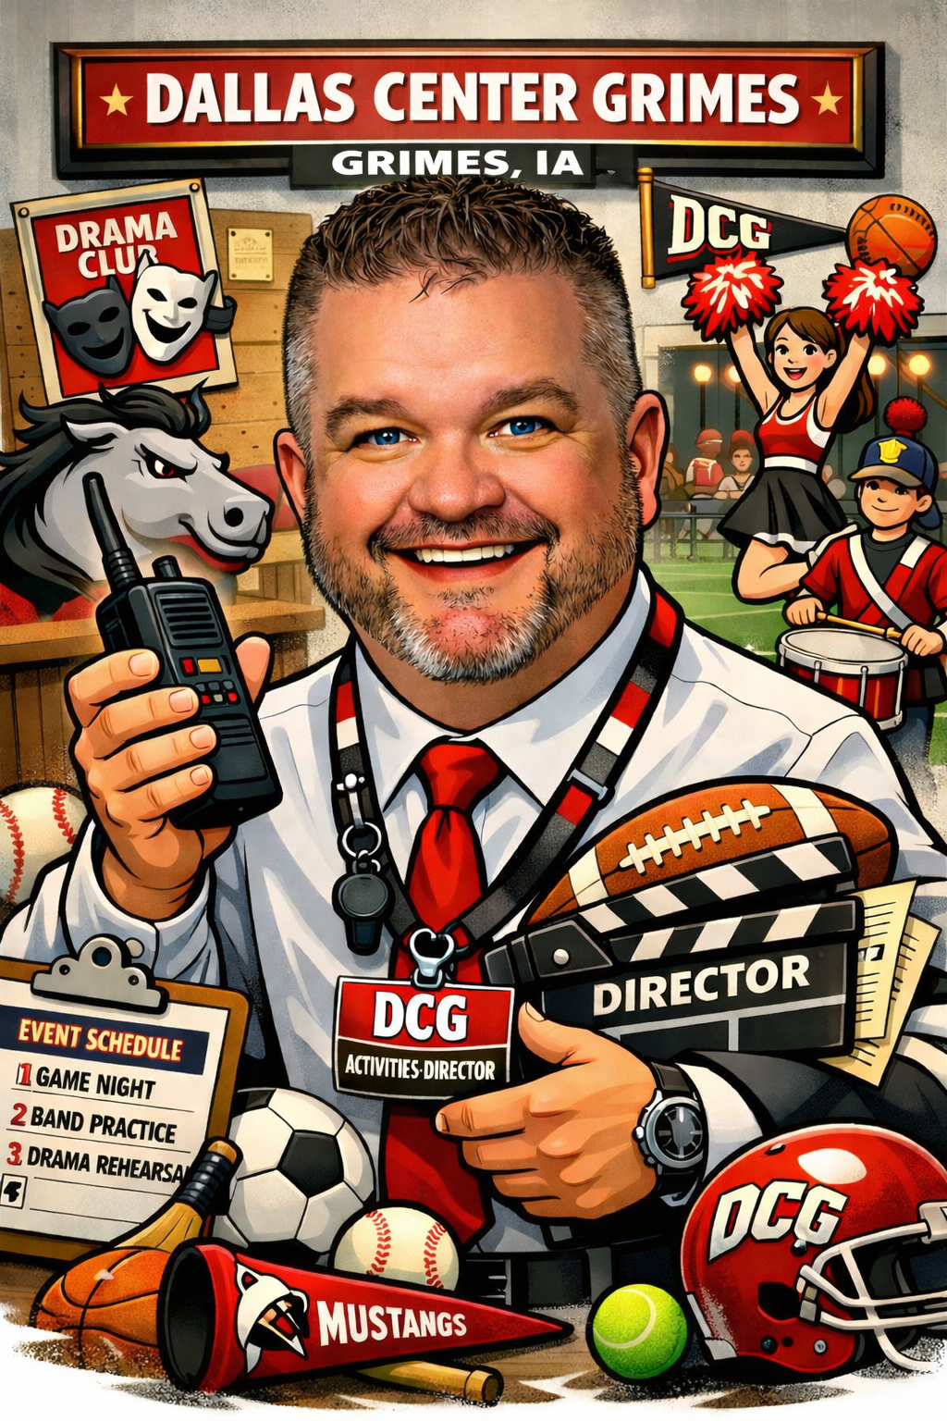
First and last day on the job photos!

Slide 3
The Shift: From Managing to Leading
Core idea: Moving from “keeping things running” to shaping the program.
Key points
Letting go of daily fire-fighting
Establishing non-negotiables and standards
Defining what success looks like beyond wins and losses
Building leadership capacity in head coaches and directors
Hook: “Year 1–2 is about survival. Year 3+ is about legacy.”
Exercise: What compliance area feels most vulnerable?
Notes:
Jim

Slide 4
Evaluating What You Inherited (and What You’ve Built)
Core idea: Honest assessment before meaningful change.
Key points
What systems are working vs. just familiar
Staff alignment with your philosophy
Program strengths, blind spots, and cultural debt
Deciding what to refine, replace, or retire
Tool idea: Simple “Keep / Improve / Replace” framework for programs, systems, and traditions.
Notes:
Jim

Slide 5
Culture Calibration: Reinforcing or Resetting Expectations
Core idea: Culture must be intentionally refreshed, not assumed. 3 Questions, PRIDE
Key points
Re-establishing standards with returning coaches and directors
Addressing “quiet drift” in expectations
Aligning values across varsity, sub-varsity, and middle school
Making culture visible Exercise: How do you make culture visible?
AD reality: Culture issues often don’t surface until year 3.
Notes:
Butch

Slide 6
What is Quiet Drift?
Quiet drift is the slow, often unnoticed erosion of standards, expectations, and alignment within a program—without a major incident or clear turning point.
Nothing is “wrong” enough to trigger an alarm, but over time the program subtly moves away from what the leader believes, expects, or intended.
Why It Often Happens After Years 2–3
Quiet drift commonly emerges after the initial transition period:
The new AD’s early urgency fades
The “new leader” grace period ends
Systems are assumed to be understood, not reinforced
Coaches/Directors grow more comfortable and test flexibility
The AD is pulled into bigger-picture work and away from daily visibility
In short: less reinforcement + more autonomy = drift.
Notes:
Butch

Slide 7
What Quiet Drift Looks Like in an Activities Department
It shows up in small, reasonable decisions that add up:
Coaches and Directors interpreting expectations differently
“That’s how we’ve always done it” returning after early changes
Inconsistent enforcement of policies across programs
Practice schedules, supervision, or communication getting looser
Coaches and Directors pushing boundaries just a little—and no one correcting it
Standards being applied based on personality, tenure, or success
Individually, each choice feels harmless. Collectively, they change the culture.
Notes:
Butch

Slide 8
The Dangerous Part
Quiet drift is dangerous because:
There’s no crisis to react to
Results may still look fine on the surface
Problems surface later as parent complaints, staff conflict, or equity issues
When addressed late, it feels like “sudden change” to staff—even though it’s correction
By the time it’s obvious, the correction is harder and more emotional.
Notes:
Butch

Slide 9
Quiet Drift vs. Healthy Autonomy
This is an important distinction for ADs:
Healthy autonomy: Coaches and Directors operate independently within clear, reinforced standards
Quiet drift: Coaches and Directors operate independently with unclear or uneven standards
The issue isn’t freedom—it’s lack of calibration.
Notes:
Butch

Slide 10
How ADs Prevent or Correct Quiet Drift
1. Re-calibrate regularly
Annual expectations meetings
Mid-year check-ins
Re-articulate non-negotiables every season
2. Make standards visible
Written expectations
Shared language
Consistent enforcement across programs
3. Increase leadership presence
Practices, meetings, and informal touchpoints
Visibility prevents drift more than memos
4. Address small misalignments early
Early correction feels manageable
Late correction feels punitive
Key insight: Quiet drift doesn’t mean failure—it means leadership maintenance is due.
Notes:
Butch

Slide 11
Quiet Drift Self Assessment
Notes:
Butch

Slide 12
Strategic Priorities for the Next 3–5 Years
Core idea: Shifting from annual goals to strategic vision.
Key points
Creating a short, realistic strategic plan
Facility, staffing, and program priorities
Budget alignment with vision
Knowing what not to chase
Exercise: Identify 3 strategic priorities that would move the department forward—not just keep it afloat.
Notes:
Jim

Slide 13
Staffing: Developing, Retaining, and Holding Accountable
Core idea: Your impact is limited by your coaches and directors.
Key points
Moving from “hire and hope” to development pathways
Clear expectations and evaluation systems
Difficult conversations with long-tenured staff
When improvement plans are necessary—and when exits are healthy
High interest topic: Managing veteran coaches as a newer AD.
Notes:
Jim

Slide 14
Systems That Scale (So You Don’t Burn Out)
Core idea: Build systems that work without you. Systems, Processes, and Procedures Link
Key points
Standardizing operations, communication, and processes
Delegation vs. “Dumping” Tasks
Empowering assistants, secretaries, and head coaches/directors
Reducing decision fatigue
Payoff: Better work-life balance and better leadership presence.
Notes:
Jim

Slide 15
“Athletic Directors Don’t Need More Hustle - We Need Better Systems”
Rob Seymour, Fishers High School - Indiana
Fulfillment and sustainability come from a lighter backpack. Systems lighten the backpack - less mental clutter, fewer fire drills, more capacity to lead and last.
Better Systems Article - Rob Seymour Fishers, IN
Notes:
Jim

Slide 16
Reframing the AD–Admin–Board Relationship
Core idea: Transitioning from reporting to influencing.
Key points
Proactively educating administrators and boards
Using data and storytelling to advocate
Aligning athletics with district priorities
Notes:
Butch

Slide 17
Community Trust and Brand Building
Core idea: Moving from “new face” to trusted leader.
Key points
Establishing consistent messaging
Managing expectations of parents and community
Crisis response after the grace period is gone
Building a recognizable identity for your athletic/activities program
Tie-in: Branding, communication, and public perception.
Notes:
Butch

Slide 18
Financial Maturity: Beyond Balancing the Budget
Core idea: Strategic financial leadership.
Key points
Long-term equipment and facility planning
Fundraising alignment with district policy
Equity and access considerations
Planning for sustainability, not just solvency
Notes:
Jim

Slide 19
The Personal Side: Avoiding the Year-3 Plateau
Core idea: AD longevity and professional growth.
Key points
Common burnout points after years 2–3
Reconnecting with purpose
Professional learning and mentorship
Leading with confidence rather than proving yourself
Notes:
Jim

Slide 20
Common Mistakes ADs Make After Year Two
Core idea: Learning from others’ missteps.
Examples
Changing too much too fast—or not enough
Avoiding tough personnel decisions (swallow the frog early)
Assuming systems are understood
Letting urgent issues crowd out important ones (responding to parents)
Notes:
Butch

Slide 21
Athletic Director Priority Matrix
IMPORTANT & URGENT (Constant fire-fighting)
• Eligibility issues
• Game day crises
• Parent escalations
IMPORTANT, NOT URGENT (Where great AD’s live)
• Coach development
• Culture building
• Strategic planning
URGENT, NOT IMPORTANT (Delegate or Limit)
• Routine interruptions
• Non-essential emails
• Last-minute asks
NOT URGENT, NOT IMPORTANT (Eliminate)
• Busy work
• Low-impact meetings

Slide 22
Legacy Thinking: What Do You Want This Program to Be Known For?
Core idea: Shifting mindset from role to impact.
Key points
Defining the “why” of the program
Aligning daily decisions with long-term identity
Leaving the program better than you found it
Notes:
Butch

Slide 23
Thank you for all that you do!
Brent Buttjer brent.buttjer@gmail.com
Jim Boehmer jimboehmer38@gmail.com
Keep Rising!!!
Notes:
Butch

